Slide 1
NPI Search
Introduction

Slide 2
Purpose
To allow a speedy entrance to the conference for medical professionals
To record as much information as possible about medical professionals as they enter the conference
Do all of this offline
Sync with a centralized server

Slide 3
But where do we get the data?
The United States government publishes a NPPES Downloadable File monthly
This file is a flat CSV (5GB) file containing hundreds of columns of data and multiple millions of rows
This data is an unprocessed CSV!
Without serious processing of this data, the tablet would never have the power to search this data

Slide 4
Technical achievements
The app itself is able to search through 4 vast SQLite databases within milliseconds.
The DBBuilder is able to sustain 90-99% CPU (32 cores) on the most powerful EC2 instance on Amazon. Utilizing all the available 40GB of RAM, the task completes in just 4 hours.

Slide 5

The system users
Set up the next conference
Look at the registrations
Set up the pre-registrations list for next conference
Sync the device at the end of the day
Keep the tablet app and database updated
Guide the attendees
We just want to get into the conference
Just have to type in our name, or sometimes just our first initial ☺
The conference staff
The CMS user
The conference attendees

Slide 6
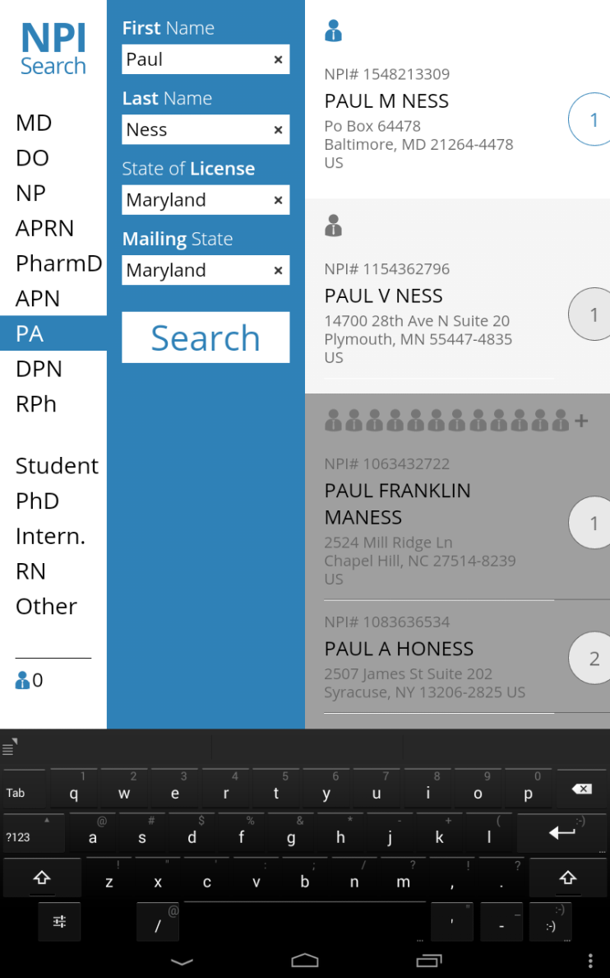
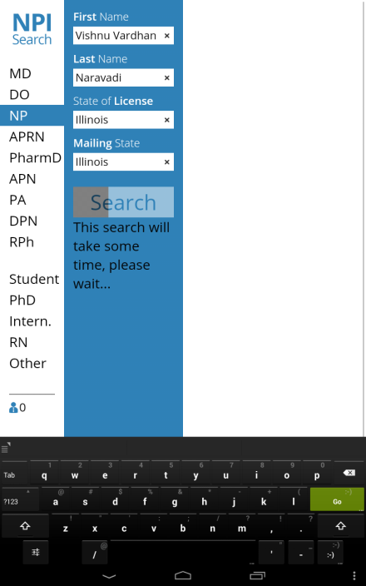
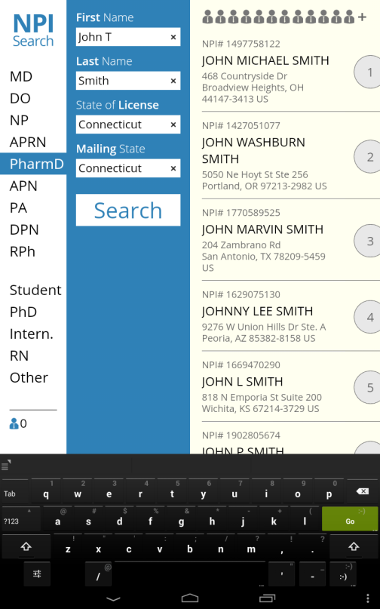
Points of view – the conference attendees

Slide 7
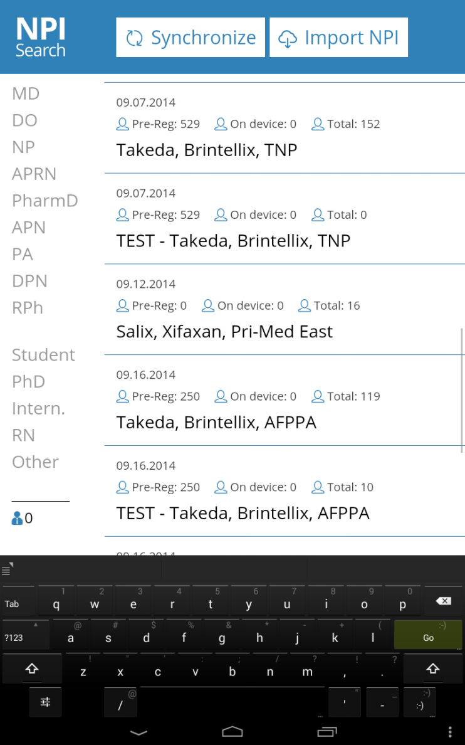
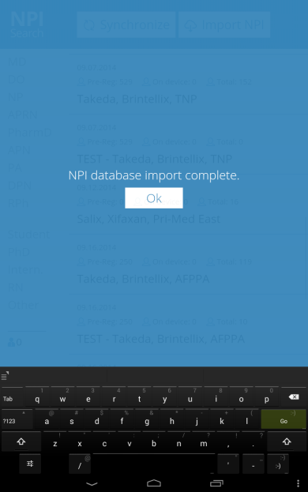
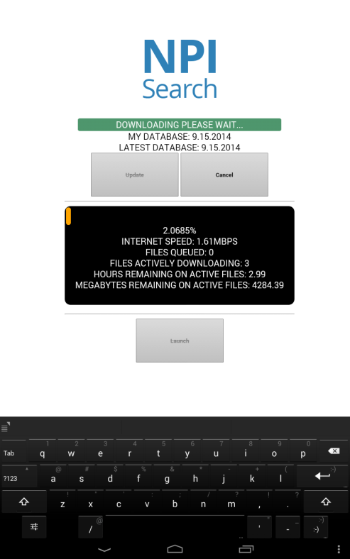
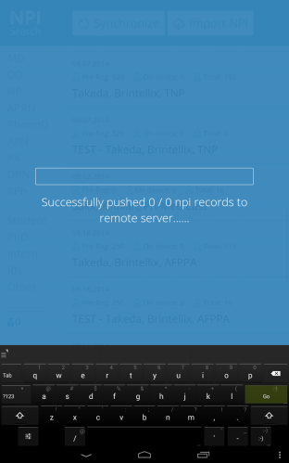
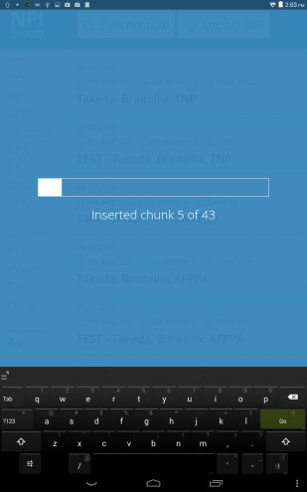
Points of view – the conference staffers

Slide 8
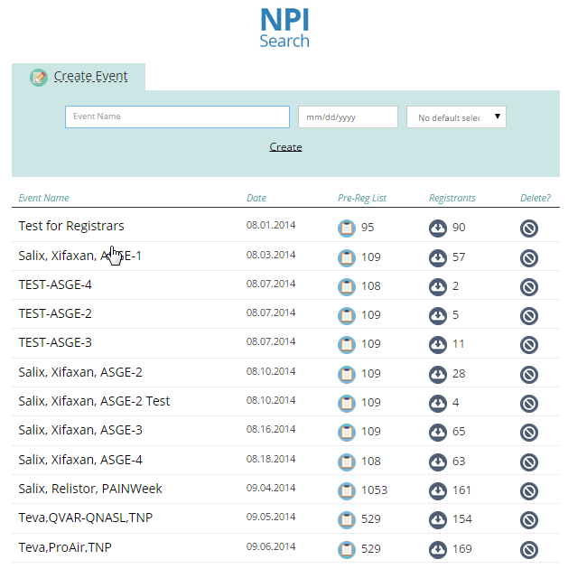
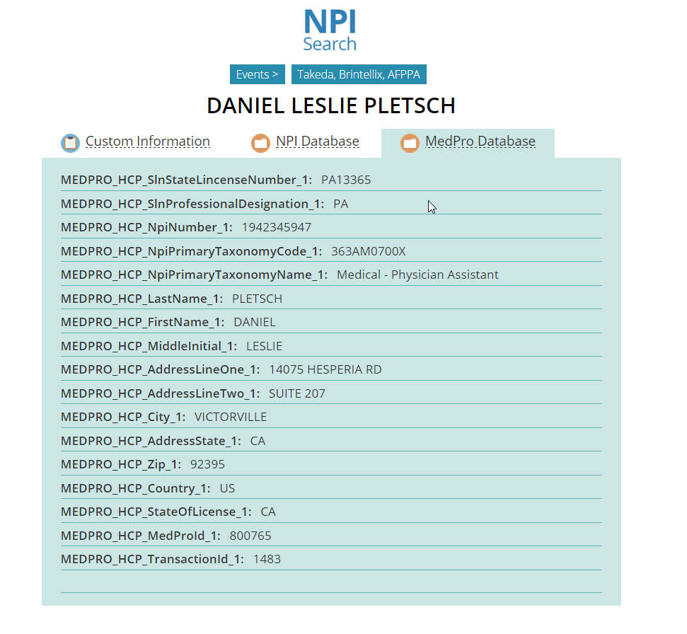
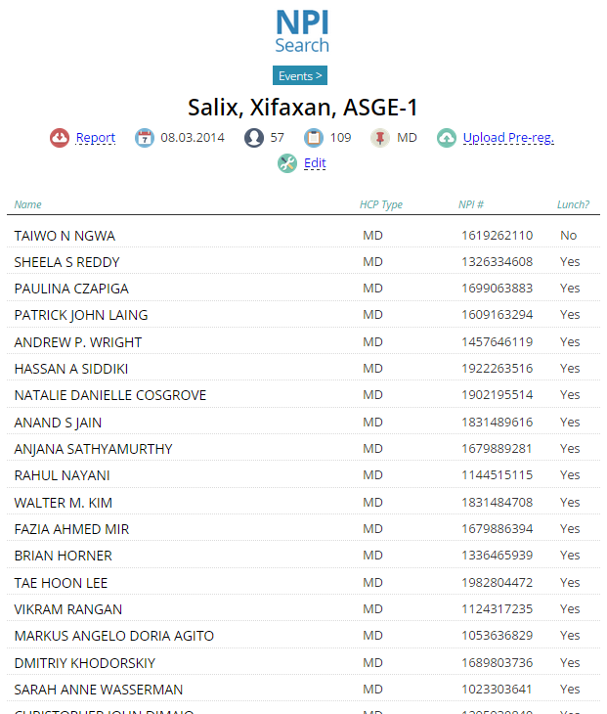
Points of view – the CMS users

Slide 9
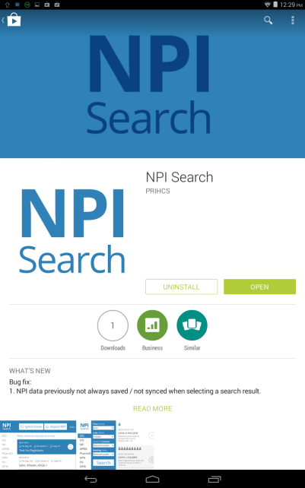

NPI Search - software ecosystem
DBBuilder

Slide 10
NPI Search
Behind the scenes

Slide 11




Android application – technologies at play

Slide 12





CMS – technologies at play

Slide 13




DBBuilder – technologies at play

Slide 14
Processes – app simplified search process
User input
Internal lookup database 400mb
User types their name and presses search
Row Ids
Row Ids
All data, all people with this name,
in all states (JSON)
Attached SQLite datastores treated as one sequential database
Internal SQLite datastore 1
Internal SQLite datastore 2
Internal SQLite datastore 3

Slide 15
Processes – app simplified sync process
Select all registrations
not already synced
Internal registration database
User presses sync in the app
Registration data,
including primary keys
App marks registrations as synced
XHR request
Primary keys of successful sync’s
returned
Sync registrations API hosted on npiapp.com

Slide 16
Processes – app simplified sync process continued…
App makes a GET call
App updates database with newly found data
Internal registration database
XHR request
Massive 8MB JSON payload (GZipped)
Sync conference, country and auxiliary data API hosted on npiapp.com

Slide 17

Processes – DBBuilder
NPI registry CSV
Name variation CSV
Group names
Split names
Smart like match
Variation matches
Get all names
Produce associations
First names
Last names
Output original first and last names but now with all associated names
lookup
datastore1
datastore2
datastore3

Slide 18
DBBuilder - parallelism in C#
The database builder, pushes the EC2 machine to its absolute limits, utilizing the maximum potential of the machine for hours on end
Effect was made to not waste CPU cycles
Threads are only spun up, if we know ahead of time they will be working hard
Well how can we know ahead of time that they will be working hard?

Slide 19
Knowing ahead of time - threads
The goal is to see CPU at 90-99% at all times in the task manager
Using termination if statements, that will result in code not being executed is very bad
This will result in threads being spun up and then spun down just to check your if statement….
Some if statements you may not even be aware of…….

Slide 20
One example within String.Contains
String.Contains() has many optimizations within
Lets look at “Ben”.Contains(“Benjamin”)….
Benjamin is a longer name than Ben!! So the above statement could never be true. String.Contains knows this ahead of time and does not bother performing hefty checks.

Slide 21
How the DBBuilder achieves 99% CPU
The smart like match algorithm
Dominic, Mehdi, Divya, Paul, Lynn, Thomas, Jude, Gregory, Wei, Allistar, Roman, Amey
Amey
Lynn
Paul
Jude
Mehdi
Divya
Roman
Dominic
Thomas
Gregory
Allistar
Wei
Take a good look at Mehdi This will happen “Mehdi”.Contains(“Wei”)
“Thomas”.Contains(“Mehdi”)
“Divya”.Contains(“Medhi”) this will not even be executed
Take a good look at Wei, everyone elses name is longer and are therefore candidates for the ‘my name inside their name’ check. Except my own name.

Slide 22
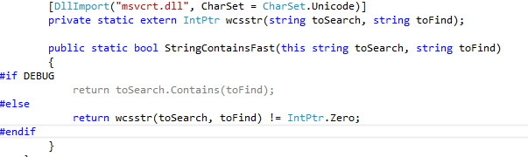
The smart like algorithm - benefits
Groups all names by name length upfront. Only provide String.Contains() with names that actually need to be checked
Inbuilt checks in String.Contains() now redundant, so bypass them altogether

Slide 23
Other powerful features to use
ArraySegment
HashSet
WebClient
WCF over TCP
Log4Net – many more features available now, need to use them on HMICMS
$size – MongoDB 2.6 now available
GZipStream
JSON.net

